Slide 2




Online Shopping
Online shopping has annual growth rate of 30% in worldwide
In Sri Lanka, online shopping is a fast growing industry now.

Slide 3
What are the key issues ?
Payments
There are many international and local payment gateways available now.
Many reliable wallets (EzCash, mCash etc…)
Delivery
Still no any proper tracking features
International Tracking Services aren’t working within Sri Lanka
Parcel lost
No one at home

Slide 4
Now,
Most of the smart phones have
Camera
GPS Sensors
Internet Access

Slide 5

Image: https://alphabetilately.org/F.html

Slide 6
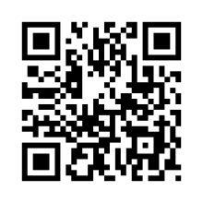
QR Codes

Slide 7


Slide 8
Receiver’s Name
House Number,
Street,
Town
ABC-12345678-D

Slide 9
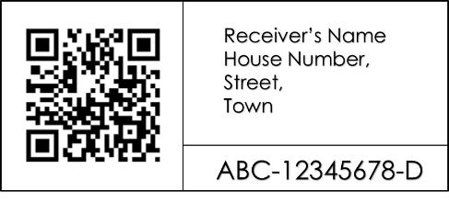

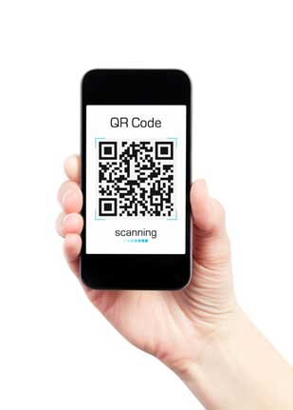

Slide 10


Slide 11
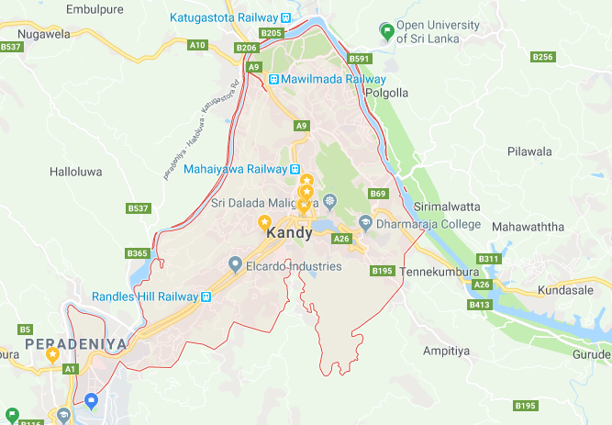
ABC-12345678-D
Search

Slide 12
How revenue generates
We creating the Platform
Platform Hiring (Charging per number of API requests)
Giving technical services.

Slide 13
Thank you
Any Questions ?

